Slide 1
H1N1 AND SEASONAL VACCINES ANALYSIS
BY
NDEDDA EMMANUEL

Slide 2
OVERVIEW
Vaccines provide immunization for individuals and enough immunization can further reduce spread of diseases through herd immunity.
In the project we revisit the public response to previous respiratory diseases ie the influenza(H1N1) vaccine.
This phone survey asked respondents whether they had received the H1N1 and seasonal vaccine . There were also questions about themselves; their social, economic and demographic background, vaccine effectiveness, opinions on risk of illness and behaviours towards mitigating transmission.
A better understanding of this data can provide guidance for future public health efforts through predictive classification modelling

Slide 3
PROBLEM STATEMENT
The government through the National Health Insuarance Fund, prepared a survey to predict whether people got the H1N1 and seasonal vaccinesusing information they shared about their backgrounds, opinions and health behaviours
For this project we use data from the National Centre of Health Statistics in the United States
The National Health Insuarance Fund would like to use this information in case of another outbreak to know how to sensitize people more on vaccine practices and boost the herd immunity and ensuring people live healthier lives

Slide 4
OBJECTIVES
1 Use the logistic regression model and decision trees model to predict whether one got the H1N1 vaccine
2 Handle the class imbalance in the models for best performance
3 Use the logistic regression model and decision trees to predict whther an individual got the seasonal vaccine
4 Handle the class imbalanace in the seasonal vaccines models for best performance

Slide 5
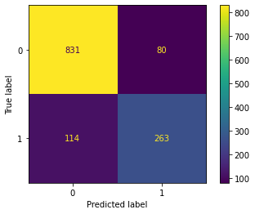
H1N1 LOGISTIC REGERESSION MODEL
This model had an accuracy of almost 85% and can effectively distinguish vaccinated class form unvaccinated class.
The logistic regression model performs better in predicting those who did not get the vaccine with high precision(0.88), recall(0.91) and f1 values(0.90)
For the vaccinated class it has lower precision(0.77), recall(0.70) and f1 score(0.73) thefore less effective in predicting those who actually got the H1N1 vaccine.

Slide 6
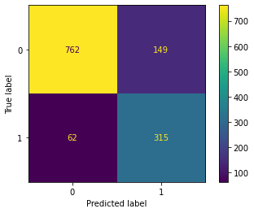
H1N1 LOGISTIC REGRESSION MODEL AFTER HANDLING CLASS IMBALANCE
After applying SMOTE, the accuracy dropped from 85% to 83%.
For the unvaccinated class, this tuned model performed better than the original model with high precision(0.92), recall(0.84) and f1 score(0.88) values
For the vaccinated class the tuned model performs poorly with low values for the precision(0.68), recall(0.84) and f1score(0.75) values

Slide 7
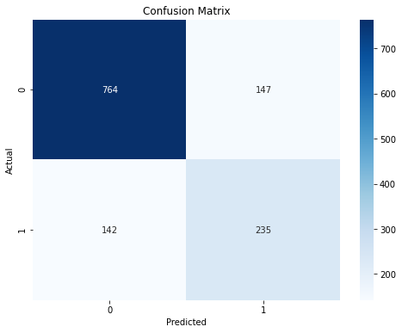
DECISION TREES MODEL FOR THE H1N1 VACCINES
This decision trees model performed poorly compared to the logistic regression model with lower accuracy of about 76% from 85%.
However, this model performs better in predicting the unvaccinated class with high values for the precision(0.84), recall(0.84) and f1 score(0.84)
As for the vaccinated class, the model performs poorly with low values for the precision(0.62), recall(0.62) anf f1 score(0.62)
After hyperparameter tuning the model, we can see an improvement in the scores but still performs poorly in predicting the vaccinated class.

Slide 8
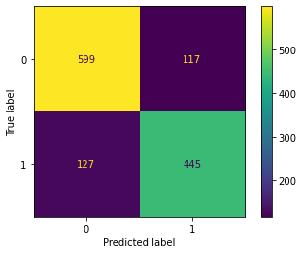
LOGISTIC REGRESSION MODEL FOR THE SEASONAL VACCINES
This model performs relatively well with an accuracy of about 81%
This logistic regression model performs better in detecting the unvaccinated class with high values for precision(0.83), recall()0.84 and f1 score(0.83)
As for the vaccinated class the model performs relatively poorly with lower precision(0.79), recall(0.78) and f1 scores(0.78)

Slide 9
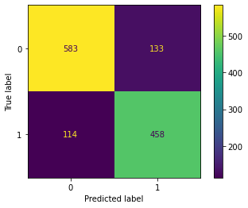
LOGISTIC REGRESSION MODEL AFTER HANDLING THE CLASS IMBALANCE
This tuned model achieved an accuracy of about 81%
The model did not differ so much from the original model with relatively similar values for precision(0.84), recall(0.81) and f1 score(0.83) for the unvaccinated class
For the vaccinated class, there are stll lower values for the precision(0.77), recall(0.80) and f scores(0.79)

Slide 10
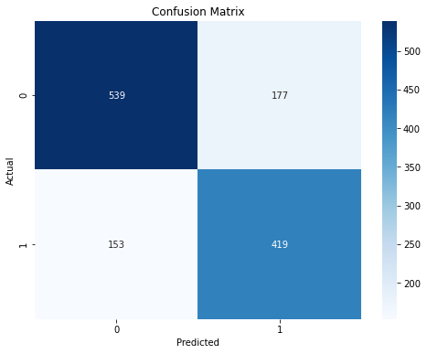
DECISION TREES MODEL FOR THE SEASONAL VACCINES
This decision trees model achieved an accuracy of about 75%. Performing slightly worse than the logistic regression model.
For the unvaccinated class, there is a drop in precision(0.78), recall(0.75) and f1 scores(0.77) compared to that of the logistic regression model
For the vaccinated class, this model slightly outperforms the logistic regression model with higher precision(0.70), recall(0.73) and f1 score(0.72) values
After tuning the model it outperforms the untuned model with higher values for the metrics in both vaccinated and unvaccinated classes.

Slide 11
FINAL RECOMMENDATIONS
All models performed better in predicting the unvaccinated class for both the H1N1 and seasonal vaccines
For the H1N1 vaccine the tuned models outperformed the untuned models improving the predictions for the vaccinated individuals. Although the logistic regression model seems to be performing better than the decision trees models
For the seasonal vaccines, the untuned logistic regression model, performs poorly in predicting the vaccinated class. After tuning the model it performs slightly better in predicting the vaccinated class. The hyper-parameter tuned decision tree model performs best in predicting both the vaccinated and unvaccinated individuals

Slide 12
